Slide 1
Welcome to Marketing Management
Dr. Cecilia Ruvalcaba
BUSI 107 Week 14, Day 2

Slide 2
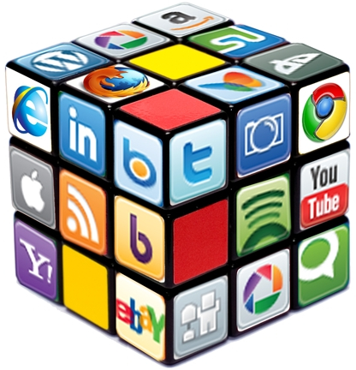
Marketing & Social Media

Slide 3
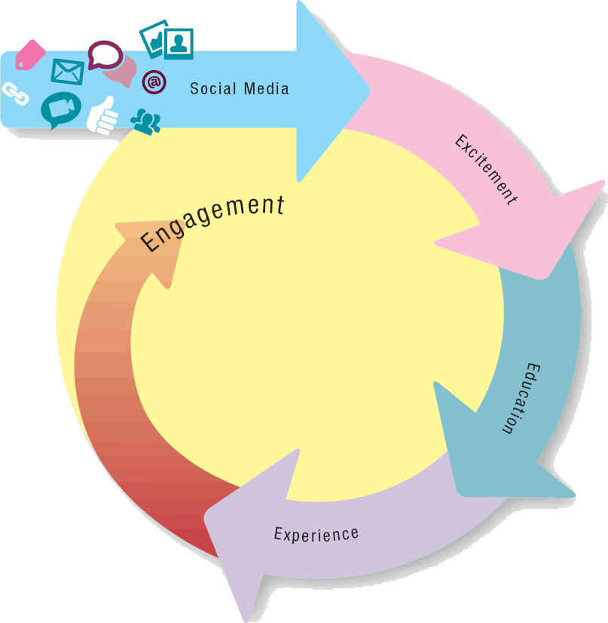
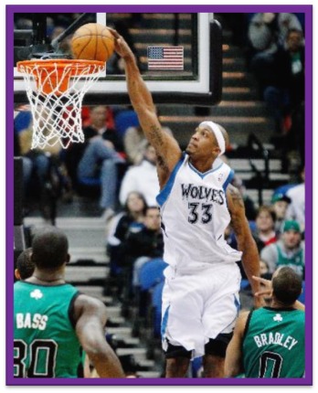
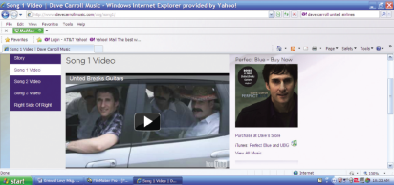

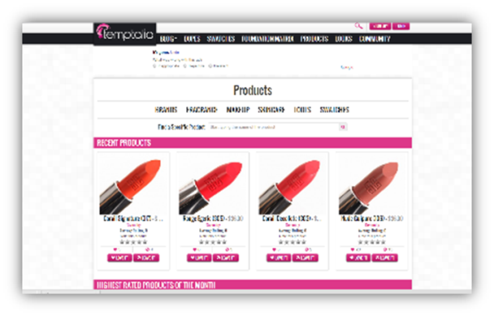
4E Framework for Social Media

Slide 4
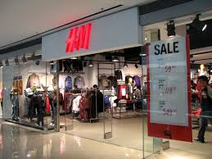
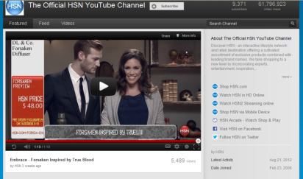
Social Network Sites
Social Network Sites:
Excellent way for marketers to create excitement
Media Sharing Sites:
Highlight how consumers can experience
Encourage consumers to engage
Thought Sharing Sites:
Blogs & Microblogs
Educate & Engage by providing two-way communication

Slide 5
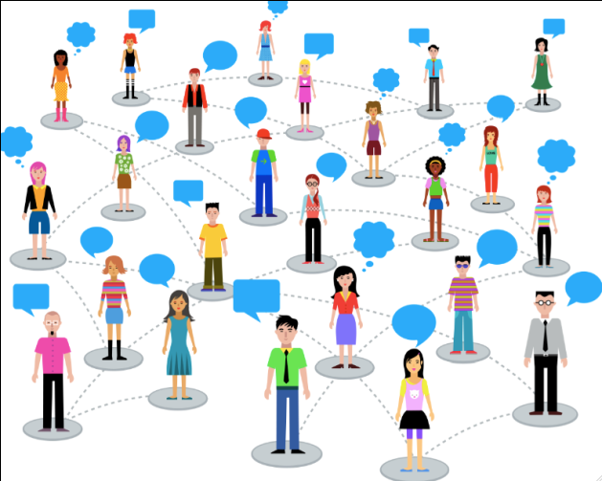
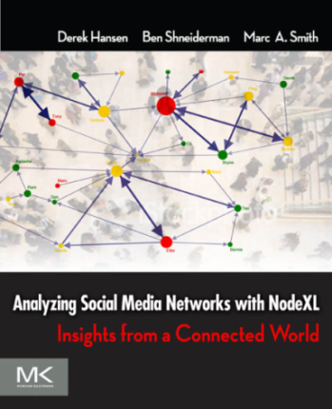

Social Networks
The Hidden Influence of Social Networks (Nicholas Christakis)
“The spread of good and valuable things is required to sustain and nourish social networks.”
Social networks are created whenever people interact, directly or indirectly, with other people, institutions, and artifacts.
Social network analysis helps you explore and visualize patterns found within collections of linked entities that include people.
NodeXL
Free Social Network Analysis Application (Twitter, Facebook, YouTube, flickr, email, blogs, wikis…)
Collect, Store, Analyze, Visualize & Publish Data
Notes:
http://www.ted.com/talks/nicholas_christakis_the_hidden_influence_of_social_networks

Slide 6
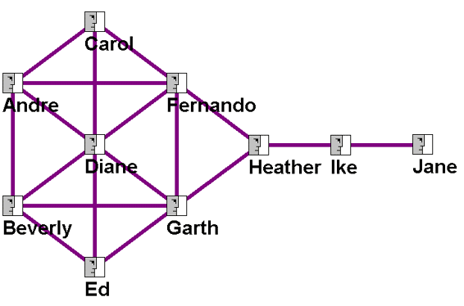
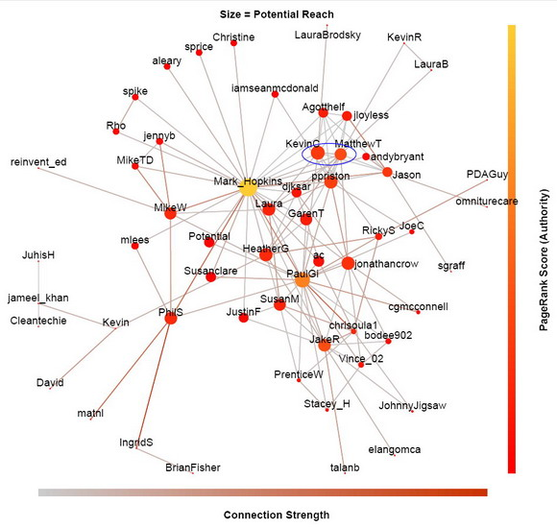
Visualizing Social networks
Actors = Nodes
Relationship = Edge
Centrality = # of Connections
Density = % of Connections
Betweenness = Distance, Location (Bridge)
Eigenvector Centrality = 2 deg of Centrality

Slide 7
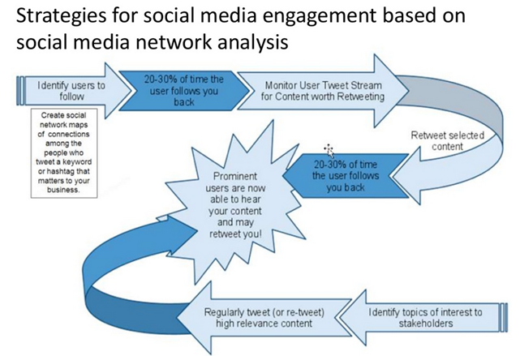

Slide 8
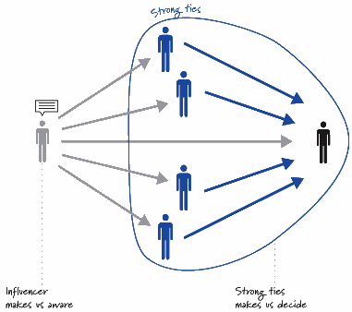
Influence, Diffusion, Contagion
Value in Influential Customers
Diffusing information beyond 1st connection. Find influentials in communities, not just friends.
The Negative Effects of Sharing
Feedback dampens creativity, reduces originality, and diminishes customer satisfaction.

Slide 9
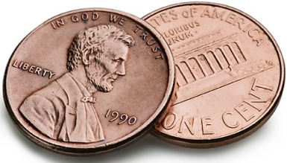
Basically there are tons of tips to do things one way or another (what platform to use, etc…) and this will continuously change.
The main point is to:
1) Understand YOUR Consumer
Who are they? How do they behave? Etc…
2) Know the SM Platforms
What tools do they offer? How can I manage it? How can I integrate it with my business & with current promotional efforts?
3) Connect with the Platform that works for you and your customers!
Make it easy to connect and share.
Encourage customers to invite people.
4) Follow-through! If you are going online then you MUST commit! This is your opportunity to connect with your customers and receive feedback. Don’t let the twitter feed end. Keep it fresh so you are on the top of your consumers minds. Give them content to share.
6) Monitor the changes! Customers are dynamic! Their preferences change and tastes change.
Marketing is not a science or an art, but a craft, and when the tools of the craft change, strategy needs to change too.

Slide 10

Next Class
Exam 3
Marketing Analysis Paper Due 5/4
Presentations: Monday 5/2 & Wednesday 5/4

